Slide 1
Data Visualization & Interpretation
Febin.A.Vahab

Slide 2
Storytelling With Data-Process

Slide 3
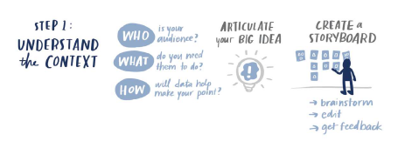
SWD

Slide 4
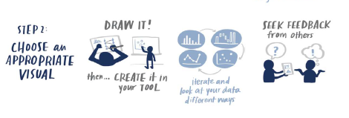
SWD

Slide 5
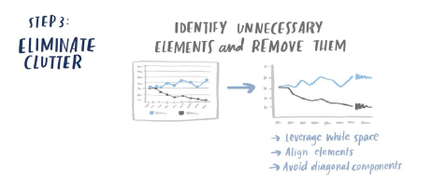
SWD

Slide 6
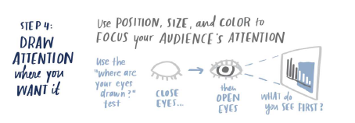
SWD

Slide 7
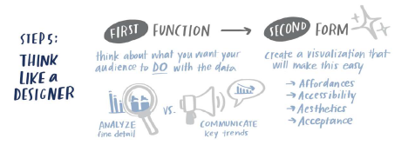
SWD

Slide 8
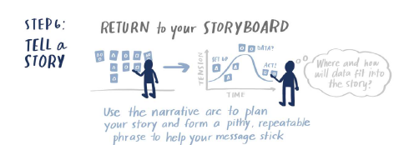
SWD

Slide 9
Case Study
As a data analyst at a national clothing retailer, you are gearing up for this year’s back-to-school shopping season. You’ve analyzed survey data from last year’s back-to-school shopping to understand customers’ experience—what they liked and what they didn’t like. You believe the data reveals some clear opportunities and want to use it to inform the strategy for this year’s back-to-school shopping season across your company’s stores.

Slide 10
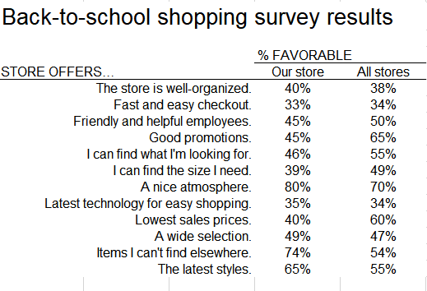
Case Study

Slide 11
Case Study
What is the story here? How would you visualize the data in Figure to lend insight into what we should focus on in this situation? Reflect on all of the lessons that we’ve covered and how you would apply them. Create your preferred visual
You will be walking your audience through this data in a meeting. How would you present the information to them? Develop your materials in the tool of your choice.
You anticipate that your audience will want you to send them content after the meeting. This will remind those who attended what was talked about as well as let folks who weren’t able to attend know what was discussed. How would you design graphs or slides to meet this need? Create in the tool of your choice.

Slide 12
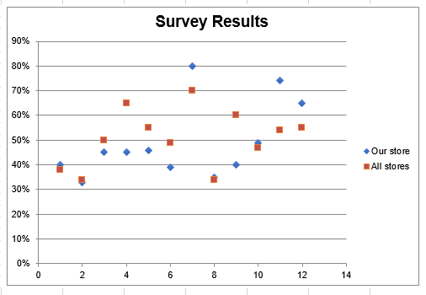
Scatterplot

Slide 13
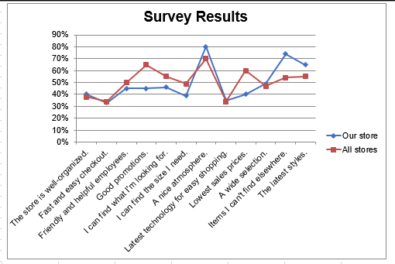
Line graph

Slide 14
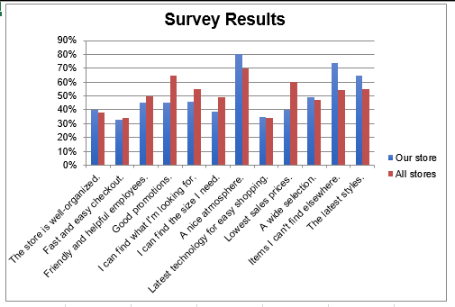
Bar graph

Slide 15
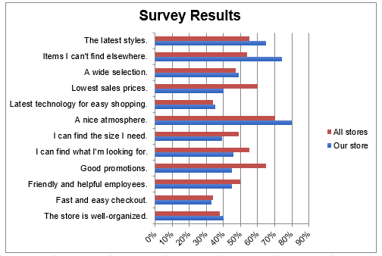
Bar graph-Horizontal

Slide 16
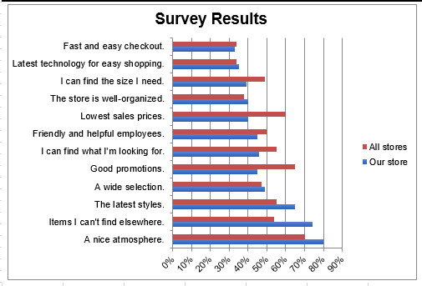
Bar graph-Horizontal-Ordered

Slide 17
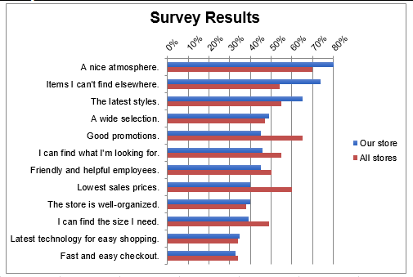
Bar graph-Horizontal-Ordered

Slide 18
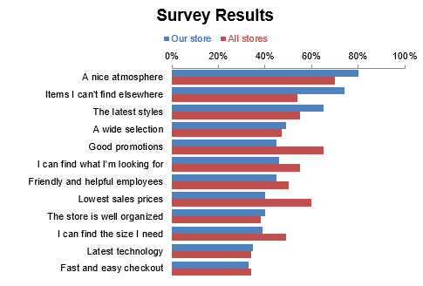
Decluttering

Slide 19
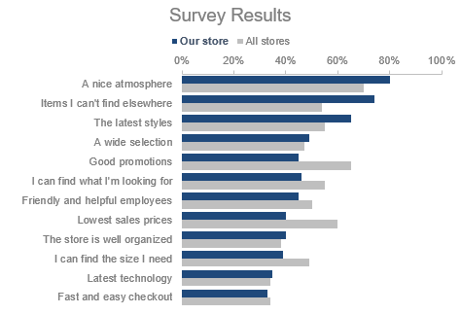
Preattentive Attributes

Slide 20
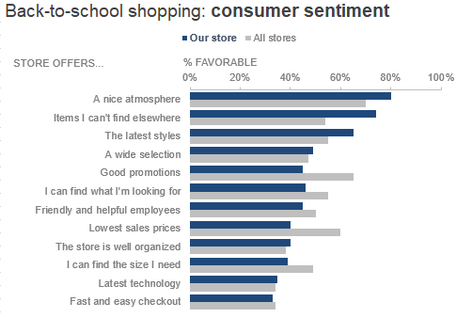
Adding words

Slide 21
Thank You!

